Slide 1


Examining Disaster Planning Interfaces of the COVID-19 Emergency Meals-to-You
Environmental Science Seminar, March 16, 2022

Slide 2
Project Aim
To examine disaster planning and health interfaces with the COVID-19 Emergency Meals-to-You program by developing strategies for mitigating food insecurity before, during and after pandemics and disasters.
Project Objectives
Examine disaster interfaces from the perspective of service providers and recipients the COVID-19 program.
Understand environmental public health services and delivery system characteristics of communities involved in the Emergency Meals-to-You program.
Develop a disaster related food security and resilience action plan for at risk communities.
Establish a plan for rapid set-up of Emergency Meals-to-You in a pandemic and disaster situation.

Slide 3
Emergency Meals to You

Slide 4
COVID-19 Emergency Meals-to-You
An estimated 29.4 million children benefit from the services provided by the National School Lunch Program offered by the United States Department of Agriculture (USDA)
Program provides food access for children who qualify for free or reduced priced lunches at school.
The COVID-19 pandemic left thousands of school-aged children with limited access to essential meal services provided by public schools.
On March 17, 2020, USDA, the Baylor Collaborative on Hunger and Poverty (BCHP), Chartwells, McLane Global, and PepsiCo announced a plan to deliver meals to students in rural areas affected by COVID-19 school closures.
An expansion of a pilot the Collaborative conducted in 2019 called Meals to You.
The EMtY program was much larger than the pilot project.

Slide 5
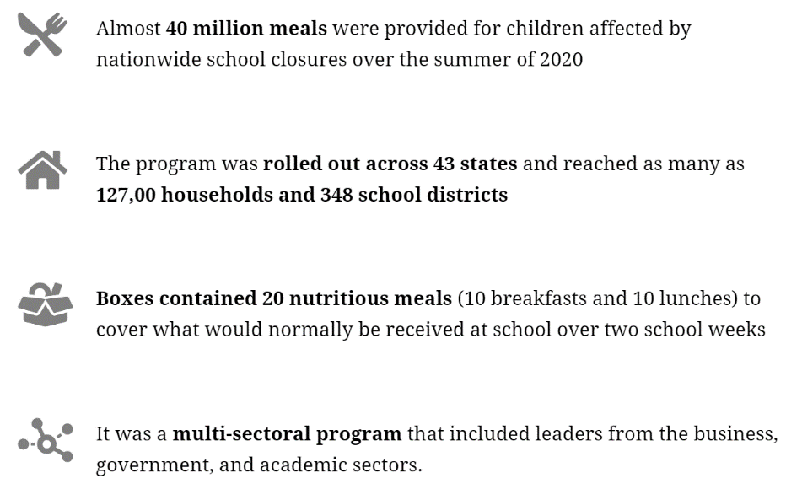
Outcome

Slide 6
Emergency Meals to You and Community Resilience

Slide 7
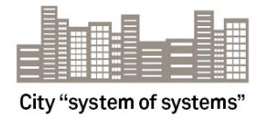
Resilience Must Embrace a “Systems of Systems”
Communities are complex because they are where multiple systems interact.
Connections abound both causal, and those related to resources and data.
Often, those connections can be a source of strength and resilience.
However, connections can be missed, and some may only emergent when a disaster happens.
This reduces resilience, because unforeseen consequences occur that may be disastrous.
Energy, Fuel
Telecommuni-cations, data
Water, sanitation
Food storage and delivery
Protective infrastructure
Healthcare, public health
Mass & private transportation,
Ecosystem services
Public safety
Social systems

Slide 8
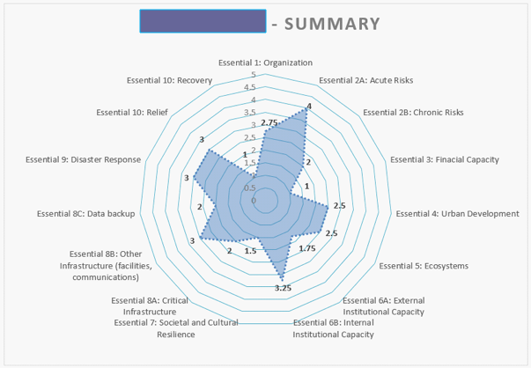

  The Disaster Resilience Scorecard for Cities
The Disaster Resilience Scorecard for Cities was co-authored by IBM and AECOM on behalf of the United Nations Office for Disaster Risk Reduction (UNDRR) and officially launched in 2017.
The City Scorecard breaks the UNDRR’s “Ten Essentials” for Making Cities Resilient into around 47-117 measurements, each scored 0 – 3 (preliminary version) and 0 – 5 (detailed version). It:
  … has now been used by ~ 200 cities worldwide, as well as by the EU for critical infrastructure resilience.
  ... has been translated into 13 languages.
  … can be downloaded for free from: https://www.unisdr.org/campaign/resilientcities/home/toolkitblkitem/?id=4
A further version of the Scorecard, for industrial or commercial buildings and campuses was recently published and is available for free from: https://www.preventionweb.net/publications/view/69845.

Slide 9
The UNDRR’s “Ten Essentials” For Making Cities Resilient
Pros:
  Relatively holistic, complete coverage of the field – both by subject and by different timescales.
  Allows “systems of systems” (technological, social, economic) to be addressed – great for making connections between these.
Con: public health issues don’t emerge clearly from this structure.

Slide 10
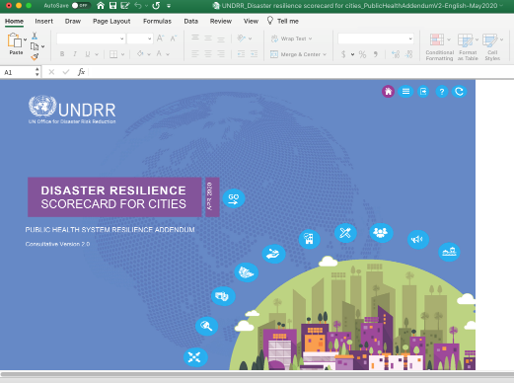
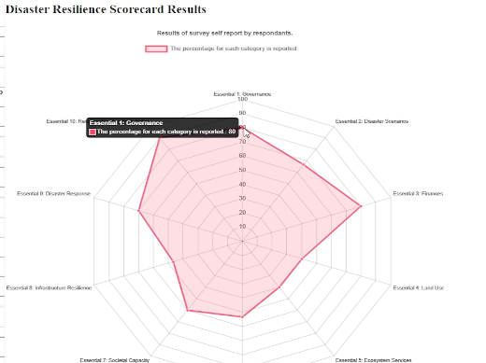
Public Health Addendum to the City Disaster Resilience Scorecard
There are two tools available to help complete the PHA:
  an Excel spreadsheet created by UN DRR, accessed from the same web page as the PHA
  An on-line tool created by Baylor University at: https://unbox.ecs.baylor.edu/ **.
The tools could be used before the workshop, with results distributed as part of the data package referenced in Step 3, earlier.
  Or, if you have enough laptops, results could be captured “live”, during the workshop itself.
  Either way, the results would then be projected for the entire workshop and discussed.
  Differences in scoring levels would be discussed, and ideally resolved in the workshop.
If you are using either tool in “live” mode, be sure that the meeting rooms have reliable internet access.
https://www.unisdr.org/campaign/resilientcities/toolkit/article/public-health-system-resilience-scorecard

Slide 11
Food System Resilience Scorecard
Based on the public health system scorecard
Proven methodology for assessing resilience and developing translatable plans.
Resilience has many definitions:
      Merriam-Webster’s: “An ability to recover from or adjust easily to misfortune or change”.
When thinking about resilience, there are many perspectives that need to be considered.
The scorecard endeavors to balance these perspectives.
Notes:
Terry Rousch

Slide 12
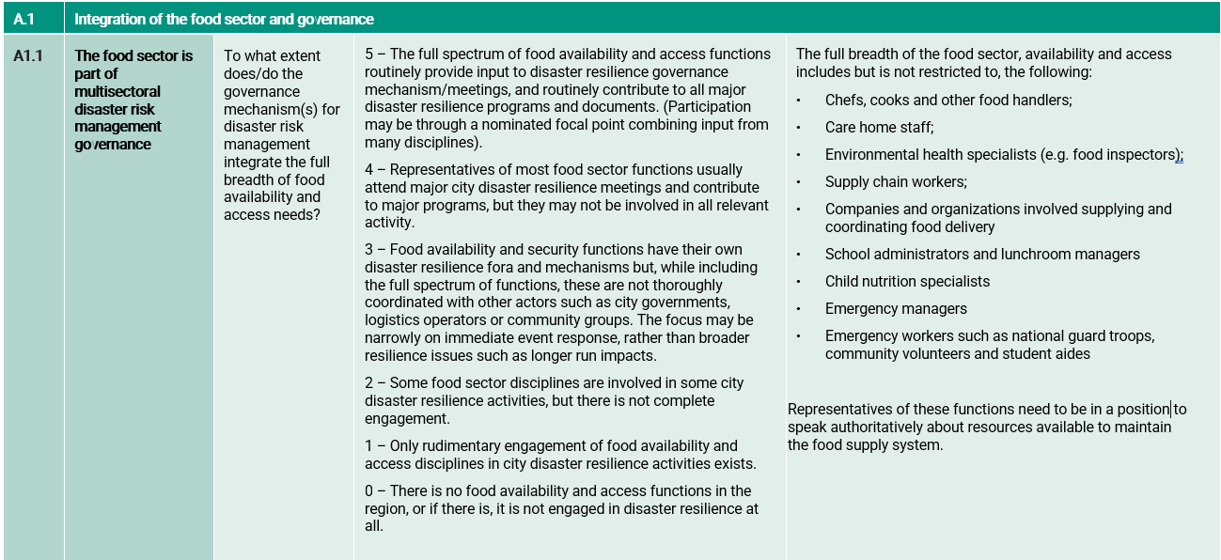
Process for workshop participants
Download/access an App for the scorecard
Review all 21 scorecard questions and discuss
Scored the questions 0-5 based on your knowledge and interpretation
Once completed we discussed and prioritized the lowest 3-5 indicators/measurements

Slide 13
Example of Scoring/Priority system – Sample Pandemic Scorecard with Description of Difficulty and Impact Scoring
4. Highly complex, multi-year project with multiple stakeholders and technology challenges. Risky.
3. Complex project with more than one stakeholder. May have some risk.
2. Less complex project – will require careful management but appears entirely feasible.
1. Relatively trivial to execute.
4
Project – Increasing public health infrastructure resilience
Project – Surge capacity
3
Project – Strengthening psychosocial support
2
Project – Strengthen supply delivery
1
Project – Planning for disaster scenarios
1
2
3
4
Minor Impact
More significant impact but in a narrow area of resilience.
Relatively significant impact over a wider area.
Transformational impact upon many areas of resilience.

Slide 14
Workshops

Slide 15
Workshops
Waco, TX, August 3, 2021 – 16 participants (11 in-person and 5 virtual)
Montgomery, AL, August 5, 2021 – 20 participants (16 in-person and 4 virtual)
Fargo, ND, August 12, 2021 – 14 participants (11 in-person and 3 virtual)
St. Louis, MO, September 15, 2021 – 10 participants in-person
Charleston, SC, January 11, 2022 - 10 participants (8 in-person and 2 virtual)

Slide 16
Waco Results
Ref. Q. | Subject/Issue | Avg. Score
A1.1 | The food sector is part of multisectoral disaster risk management governance | 2.6
A1.2 | The emergency meals-to-you program was part of COVID-19 disaster governance | 2.9
A2.1 | Inclusion of food availability/access emergencies as disaster scenarios for disease outbreaks, pandemics, water shortages and other events in their own right | 2.8
A2.2 | Inclusion of foreseeable food sector impacts on disaster risk scenarios such as a flood, hurricane, tornado, or earthquake. | 2.4
A2.3 | Inclusion of pre-existing chronic health issues and nutritional needs in food sector disaster planning | 1.9
A3.1 | Funding for food availability and access as part of resilience | 2.3
A4.1 | Conformance of key sector facilities with resilient land zoning and building codes | 2.1
A5.1 | Preservation and management of ecosystem services that provide food sector benefits | 2.6
A6.1 | Availability of the food sector workforce with relevant competencies and skills for disaster resilience | 2.4
A6.2 | Sharing of food sector systems data with other stakeholders | 2.7
A7.1 | Effectiveness of food sector systems in community engagement in context of disaster risk management | 2.4
A7.1.2 | Community access to the Emergency Meals-to-You program | 2.4
A7.2 | Ability of the Emergency Meals-to-You program to meet community food availability and access needs during an epidemic, pandemic or disaster | 2.8
A8.1 | Strengthening of the structural and non-structural safety and functionality of food sector infrastructure | 2
A8.2 | Surge capacity for food supply and access | 2.1
A8.3 | Continuity of food service delivery to schools | 2.6
A9.1 | Early warning systems for food-related emergencies | 2.5
A9.2 | Integration of the food sector with emergency management | 2.3
A9.3 | Ability to deliver food supplies to people in need. | 2.5
A10.1 | Mitigating long term impacts on the food sector and well-being | 2.6
A10.2 | Learning and improving | 2.8
Notes:
During break, input average scores. Go through summary table with group… identify 3-5 subjects/measures that have the lowest scores. Highlight. Use on Priority Grid on next slide.

Slide 17
Waco Priority Actions
Sharing of data about nutritional needs at the school level
Mapping farm to school to table to identify resilience needs
Strengthening of local food providers
Surge capacity for rural locations

Slide 18
Montgomery Priority Actions
Representation on local emergency committee (school/food sector)
Representation on multi-sectoral committees (school)
Local plans for food availability and access (school district with church etc)
Meeting nutritional needs and sharing allergy needs with local emergency committee

Slide 19
Fargo Priority Actions
The emergency meals-to-you program was part of COVID-19 disaster governance
Inclusion of food availability/access emergencies as disaster scenarios for disease outbreaks, pandemics, water shortages and other events in their own right
Inclusion of foreseeable food sector impacts on disaster risk scenarios such as a flood, hurricane, tornado, or earthquake
Inclusion of pre-existing chronic health issues and nutritional needs in food sector disaster planning
Funding for food availability and access as part of resilience
Community access to the Emergency Meals-to-You program

Slide 20
St. Louis Priority Actions
Preservation and management of ecosystem services that provide food sector benefits
The emergency meals-to-you program was part of COVID-19 disaster governance
Mitigating long term impacts on the food sector and well-being
Availability of the food sector workforce with relevant competencies and skills for disaster resilience
Early warning systems for food-related emergencies

Slide 21
Charleston Priority Actions
Promoting, monitoring, and assessing school and community foodservice needs through local emergency management structures
Leverage existing food sector capacities to establish and improve disaster risk management mechanisms
Identify lead stakeholders and engage priority responders in local food availability and access
Develop and establish adaptable early warning systems for local food sector disruption

Slide 22
Focus Groups and Interviews

Slide 23
Focus Groups and Interviews
eMTY Program Components/Themes
Three focus groups
  McLane Global (n=3)
  PepsiCo Food for Good (n=3)
  Chartwells (n=5)
Nine interviews
  BCHP (n=3)
  UPS (n=2)
  USDA
  Canteen
  General Mills
  Emergency management professional
Manuscript completed, submitted for publication
Activation
Public/private partnership
Relationships and experience
Eligibility
Emergency Meals to You Program
Food quality and branding
Centralized communication
Logistics and transport
To school/household
Food to school children and families in need

Slide 24
Focus Groups and Interviews – Strategies Recommended
Establishing a fully procurable menu that is costed and compliant with school needs and the USDA.
Understanding and documenting population served as part of school lunch programs, such as dietary needs, and sharing this with the local emergency management committee.
Identifying surge capacity in transportation and supplies at the local level.
Incorporating food access and security at schools to emergency operations center functions/activities (local and district level).
Exercising plans, agreements, protocols, and for providing food during a disaster situation.
Tailoring communication strategies to suit the school community (e.g. email or text message).
Maintaining a list of individuals and addresses for targeted deliveries

Slide 25
Summary and Potential Next Steps

Slide 26
Accomplishments to Date
Disaster Plan Completed
All Workshops and Workshop Reports Completed
Summary Report on All Workshops in Progress
Manuscript “Mobilizing and delivering essential meals to children and families affected by school closures during COVID-19 and beyond” accepted for publication by The Journal of School Health
Panel presentation about the project scheduled for the National Environmental Health Association annual conference, June 28 - July 1, 2022.
Drs. Ryan, Brooks and Brickhouse met with Baylor lobbyist Arnold and Porter, and staff from Senator Cornyn’s Office in Washington DC, January 6 and 7, 2022.
A No-Cost-Extension has been requested, to complete a national survey of EMTY participants

Slide 27
Selected Priority Actions
Include pre-existing chronic health issues and nutritional needs in food sector disaster planning (focus groups, interviews and workshops)
  For example, sharing de-identified data about nutritional needs from the school level with local emergency management committee (i.e. number kids with diabetes, peanut allergies, etc).
Create maps of distribution hubs, social determinants of health, disaster footprints, critical infrastructure, etc. (focus groups and interviews)
Incorporate schools and the food sector into the local emergency committee structure (workshops)
Strengthening of local food providers, and coordination mechanisms especially in urban areas (workshops)
Capture regional strengths of vendors and shippers to develop response plan. Merge for nation-wide disasters (focus groups and interviews)
Establish adaptable early warning systems for local food sector disruption (workshops)
Distinct differences in urban and rural food and community resilience needs (workshops):
  Rural areas more austere in resources and transport, EMTY may be only option in future emergencies
  Urban areas sometimes have too many programs, but poorly coordinated
  Role for Baylor to address these needs in new community-based efforts?

Slide 28
Future Considerations
Each community has a different vision for improving food and community resilience
BCHP has established community-based partnerships
Are sources of funding available to help bring these plans to fruition?
The potential for mapping food deserts, co-morbidities, disaster footprints, critical infrastructure, etc., could provide roadmap for most impactful infrastructure investments
Potential to develop these roadmaps for forthcoming federal infrastructure funding?
Intersection with emergency management system - Work with local emergency committees to map and strengthen local food supply chains to schools.
This could also link in nutrition by mapping and strengthening local access to healthy foods, especially in rural areas and urban food deserts.
Consider options for enhancing environmental health services at the school level (for example, there are 254 County’s in Texas but just over 100 health departments)

Slide 29
Thank you – Questions?
Benjamin J. Ryan Ph.D., MPH, REHS
Clinical Associate Professor
Environmental Health Science Program
E: benjamin_ryan@baylor.edu
Bryan W. Brooks Ph.D., MS
Distinguished Professor
Environmental Health Science Program
E: bryan_brooks@baylor.edu
Mark Brickhouse Ph.D.
Project Manager
Baylor University Health Services
E: mark_brickhouse@baylor.edu

